Slide 1














HOSPITAL
SUPPLY CHAIN
BY SHARVANI MAHADIK

Slide 2

INTRODUCTION:
PROBLEM STATEMENT:-
Hospitals face challenges like delivery delays, unreliable suppliers, and stock shortages, impacting patient care. This project analyzes supply chain data to identify trends, improve supplier selection, and optimize purchasing decisions
OBJECTIVES:-
  Understand hospital supply chain data to reduce inefficiencies, cut costs, and improve delivery timelines.
  Identify top suppliers, track order fulfillment, and analyze inventory trends.
DATASET OVERVIEW:-
  Contains real hospital supply data, covering supplier details, order quantities, delivery statuses, and costs.

Slide 3

DATA SOURCES
SOURCE TYPE:-
CSV files, SQL databases
STRUCTURE OF THE DATA:-
  Rows: It contains 8000 rows Each represents an order placed to a supplier.
  Columns: It contains 10 clumns
  Which includes:-
  Id,
  Supplier name
  Item Name
  Order date
  Delivery date
  Storage location
  Cost per unit
  Quantity
  Stock status
  Total cost

Slide 4



ARCHITECTURE DIAGRAM
DATA COLLECTION
PYTHON
SQL SERVER STUDIO
POWER BI

Slide 5

DATA CLEANING & TRANSFOMATION
DATA CLEANING:-
  Handleld missing values
  Removed duplicates
  Coreected data types
  Created new fields for analysis
DATA TRANFORMATION
  Created new columns
  Created DAX measures

Slide 6
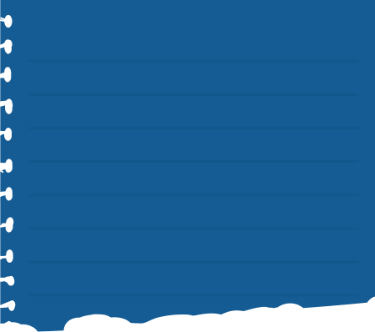

DATA INSIGHTS
SQL SERVER
POWER BI
  Ranked suppliers based on order volume.
  Found the most reliable and least reliable suppliers based on delivery performance.
  Identified which month had the highest hospital orders
  Hghest and lowest item in supply
  Determined total spending per supplier
  Average time take for delivery
  Identity the items which are about to expire
  Created few cards and KPI for total order,revenue and average cost
  Pie charts for expiey and stock status
  Donut chart delivery status and location
  Line chart for monthly trend
  Bar chart for orders by supplies
  Colum chart for orders by year and location
  Funnel chart for delivery status and cost
  Sctterplot forper unit supplies
  Waterfall for cost by suppliers

Slide 7
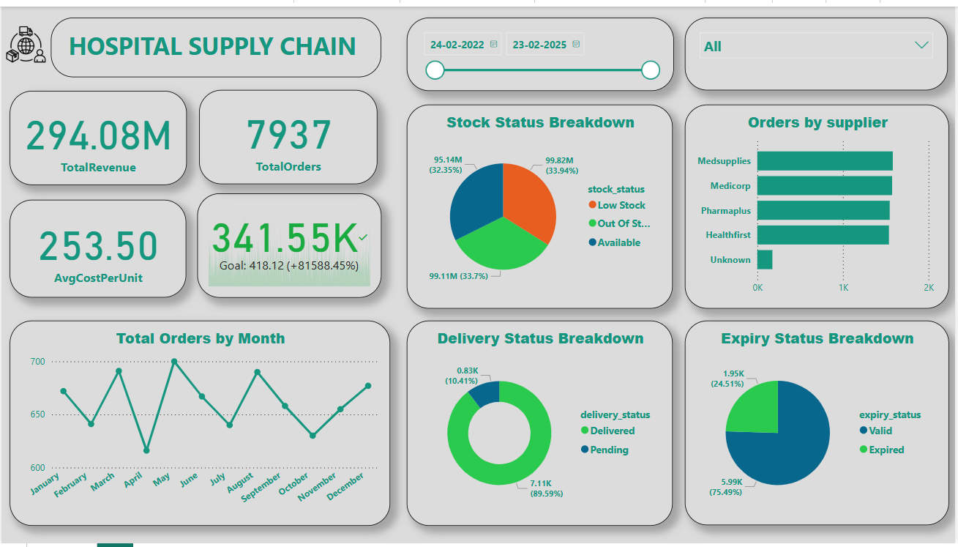
POWER BI DASHBOARD

Slide 8
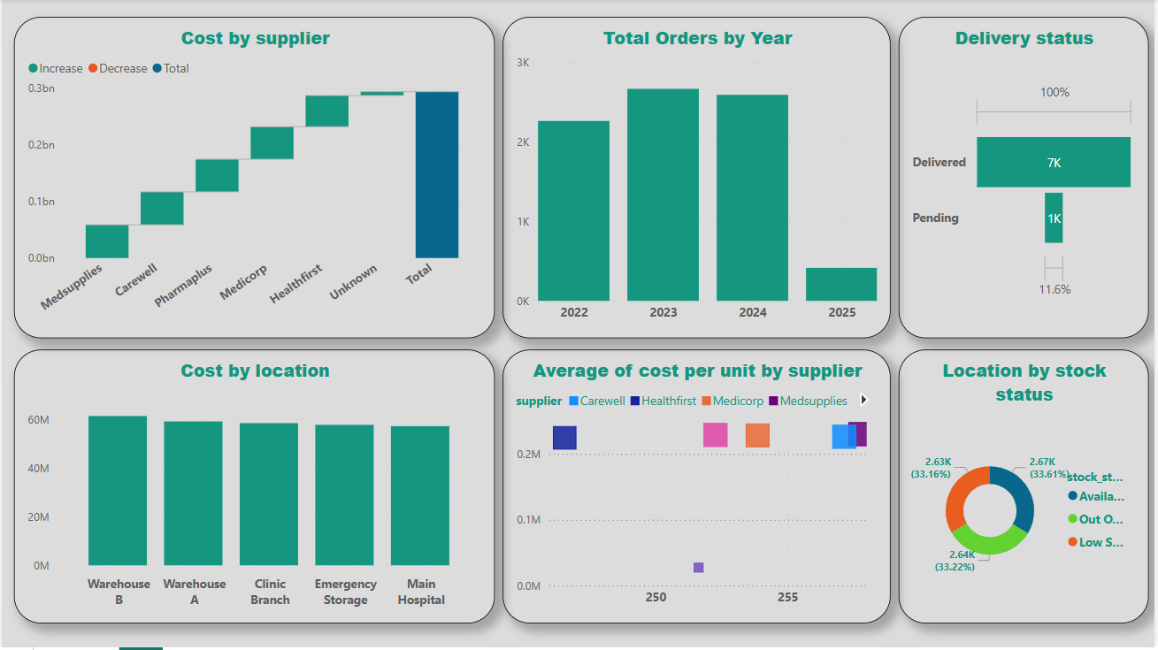
POWER BI DASHBOARD

Slide 9
THANK YOU VERY MUCH!

